Slide 1
HADOOP PROJECT CENSUS (BIG) DATA ANALYSIS
USING MAPREDUCE FRAMEWORK AND ANALYSIS THROUGH HIVE AND PIG
BY- AKSHAY KHATTER
Notes:
This presentation demonstrates the new capabilities of PowerPoint and it is best viewed in Slide Show. These slides are designed to give you great ideas for the presentations you’ll create in PowerPoint 2011!
For more sample templates, click the File menu, and then click New From Template. Under Templates, click Presentations.

Slide 2
WE HAVE DONE ANALYSIS ON SAMPLE DATA USING:
1
2
3
MAP-REDUCE PROGRAMS IN JAVA
APACHE PIG
APACHE
HIVE
We have given screenshots for every step of the project

Slide 3
Designed and created by:
1
AKSHAY KHATTER
MAHARAJA AGRASEN INSTITUTE OF TECHNOLOGY B.TECH CSE
EMAIL : akshaykhatter97@gmail.com

Slide 4

MapReduce is a processing technique and a program model for distributed computing based on java. The major advantage of MapReduce is that it is easy to scale data processing over multiple computing nodes. Under the MapReduce model, the data processing primitives are called mappers and reducers. But, once we write an application in the MapReduce form, scaling the application to run over hundreds, thousands, or even tens of thousands of machines in a cluster is merely a configuration change. This simple scalability is what has attracted many programmers to use the MapReduce model.
MAP REDUCE

Slide 5
HOW TO RUN THE MAPREDUCE PROGRAM:
WRITE ALL PROGRAMS IN ONE FOLDER
COMPILE ALL PROGRAMS IN THAT FOLDER ON HADOOP
RUN THE FILE BY OPENING HADOOP.LOGIN
CREATE A .JAR FILE WITH ALL COMPILED PROGRAMS
Notes:
The following slides show several examples of timelines using SmartArt graphics.
Include a timeline for the project, clearly marking milestones, important dates, and highlight where the project is now.

Slide 6
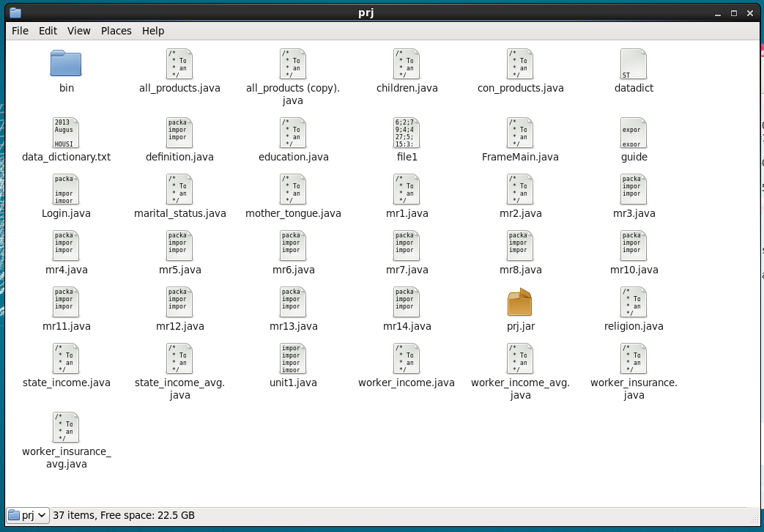

Slide 7
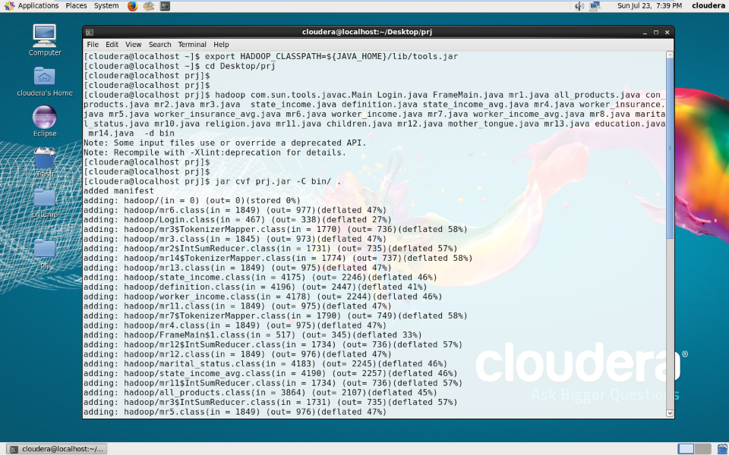
COMPILATION PROCESS OF ALL PROGRAMS
CREATING PRJ.JAR

Slide 8
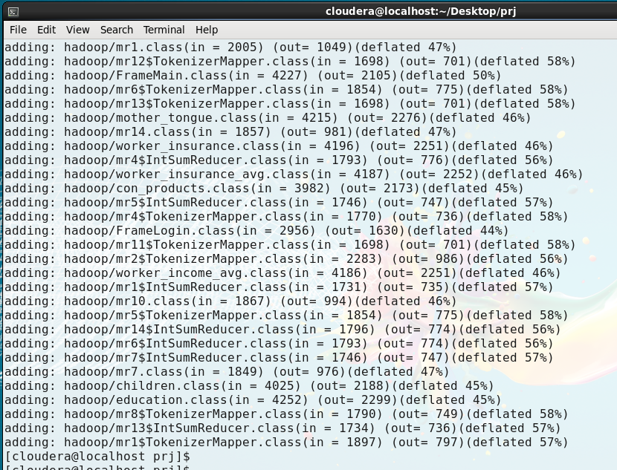

Slide 9
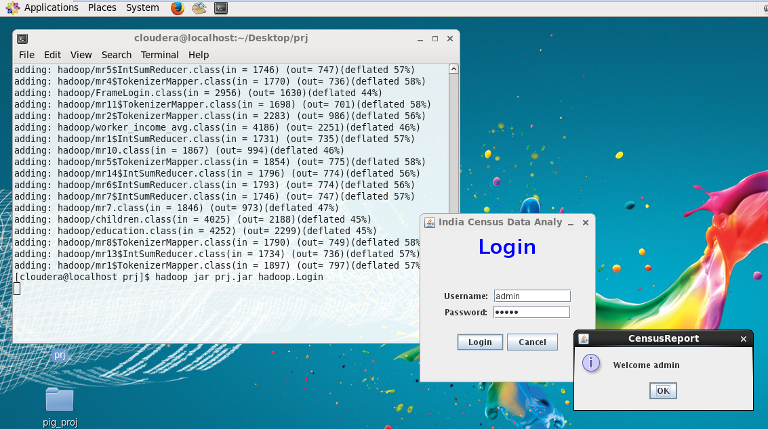
LOGIN OUTPUT
Final step to Run the Program

Slide 10
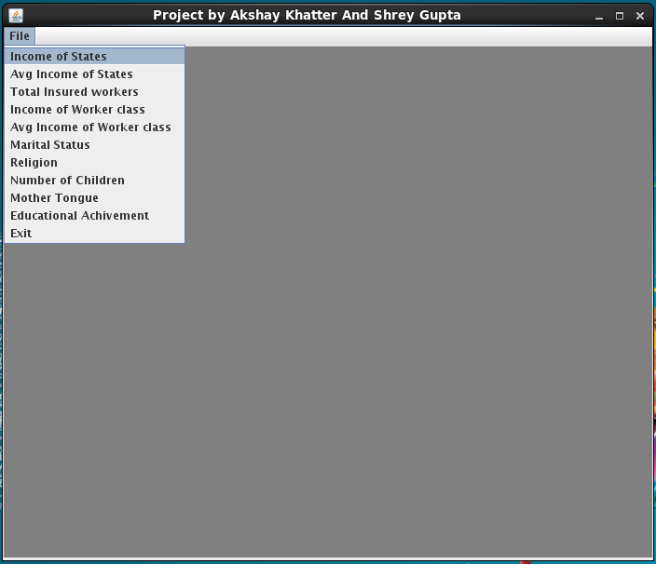
PROJECT WINDOW

Slide 11
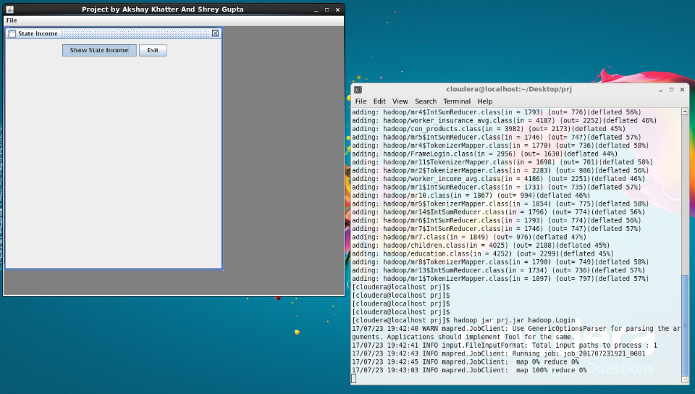
RUNNING ANALYSIS TO CALCULATE SUM OF INCOME STATE WISE

Slide 12
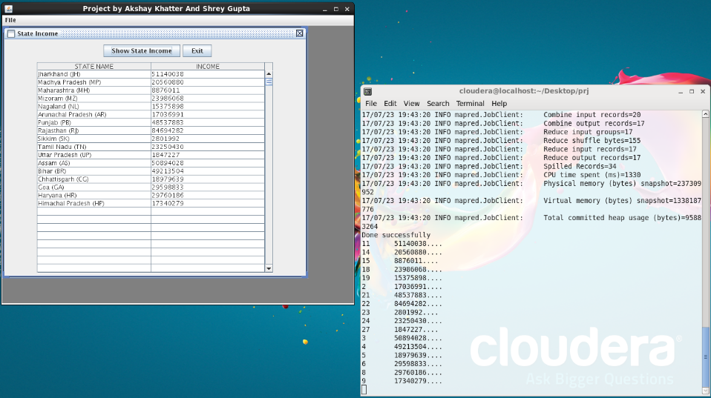
FINAL OUTPUT

Slide 13
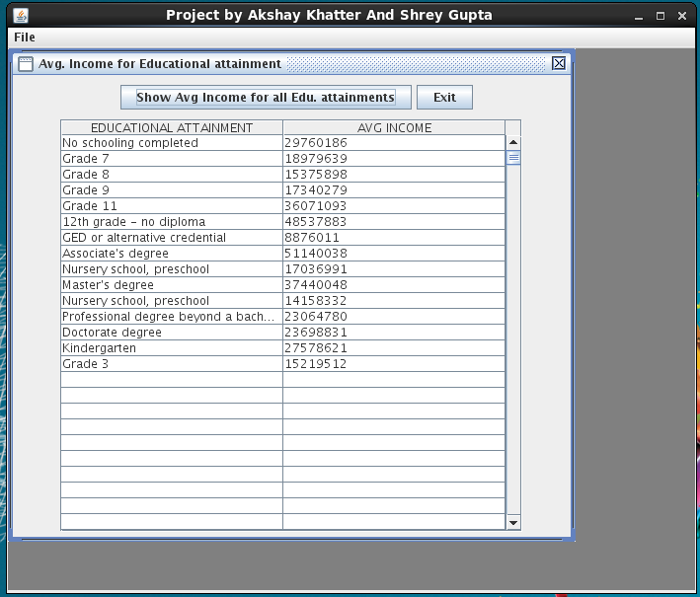
CACULATING AVG. INCOME FOR A PERSON WITH PARTICULAR EDU. ATTAINMENT

Slide 14

Apache Pig is an abstraction over MapReduce. It is a tool/platform which is used to analyze larger sets of data representing them as data flows. Pig is generally used with Hadoop; we can perform all the data manipulation operations in Hadoop using Apache Pig.
2
APACHE PIG

Slide 15
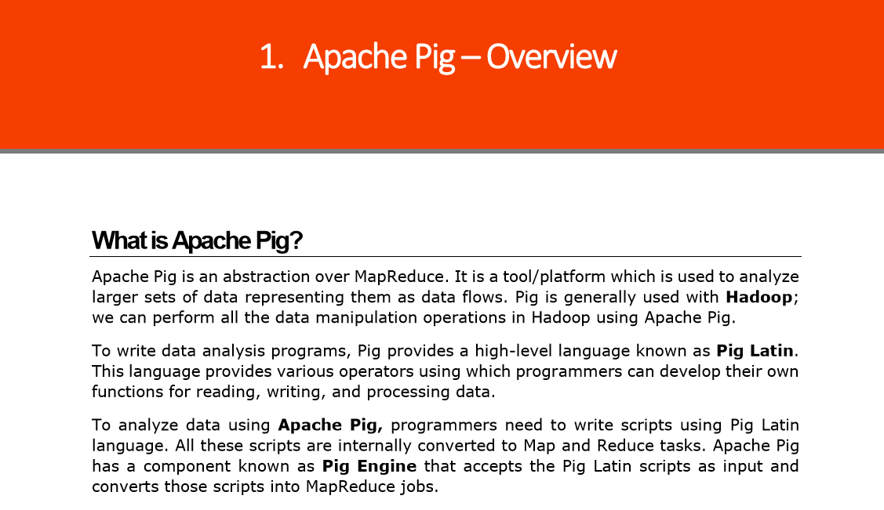

Slide 16
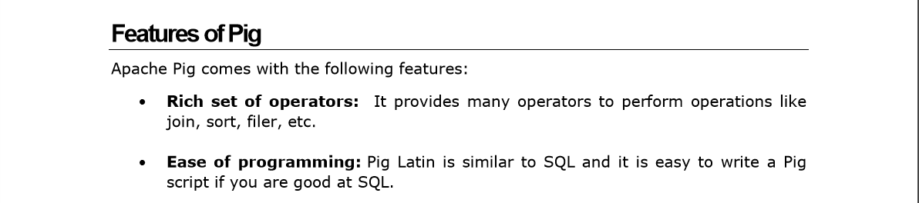
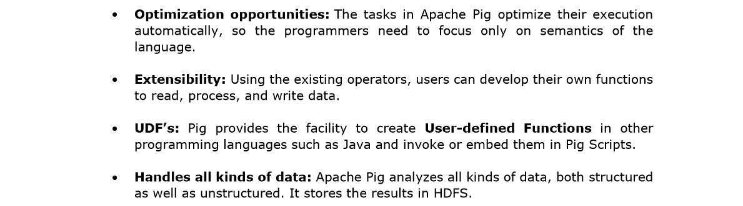

Slide 17
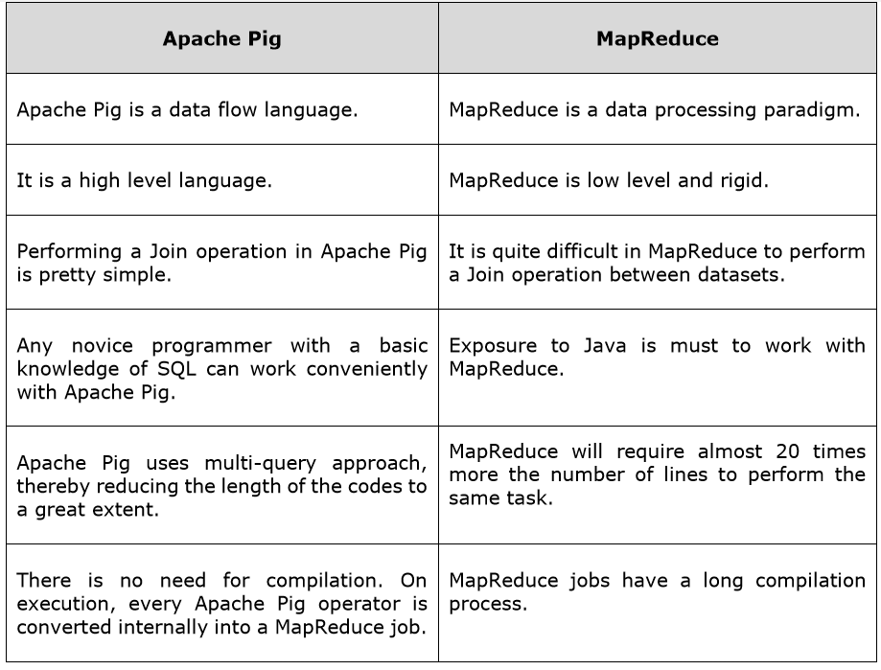

Slide 18
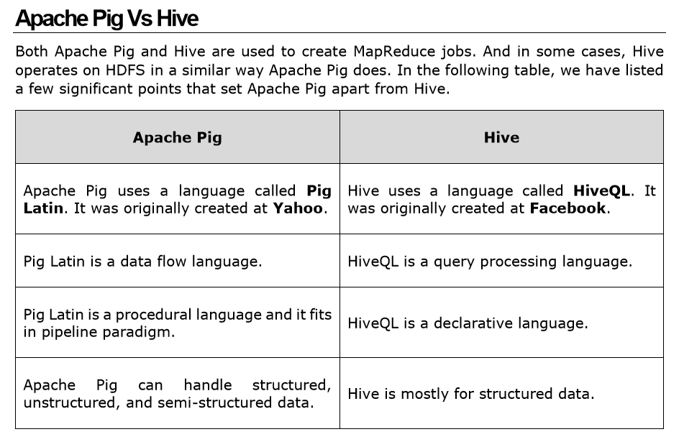

Slide 19
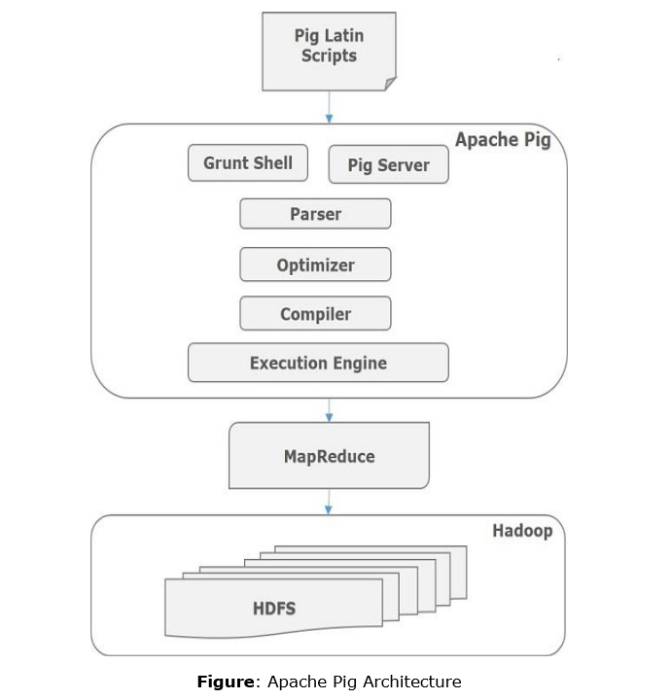

Slide 20
HOW TO RUN ANALYSIS USING PIG:
LOAD SAMPLE DATA INTO HDFS
WRITE PIG SCRIPT FOR PARTICULAR OPERATION
EXECUTE PIG SCRIPT
OPEN OUTPUT FILE FROM HDFS

Slide 21
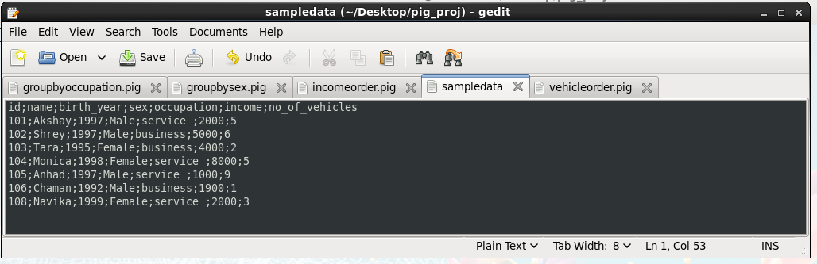
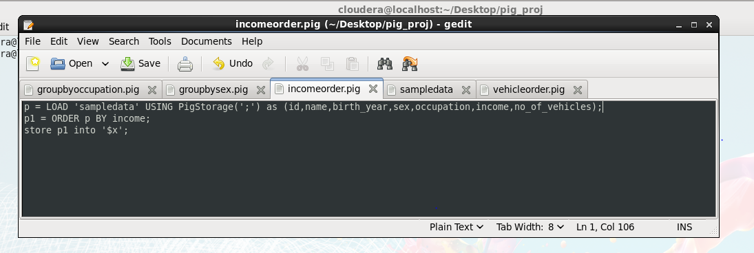
SAMPLE DATA SET
WRITING PIG SCRIPIT IN .PIG FILE

Slide 22
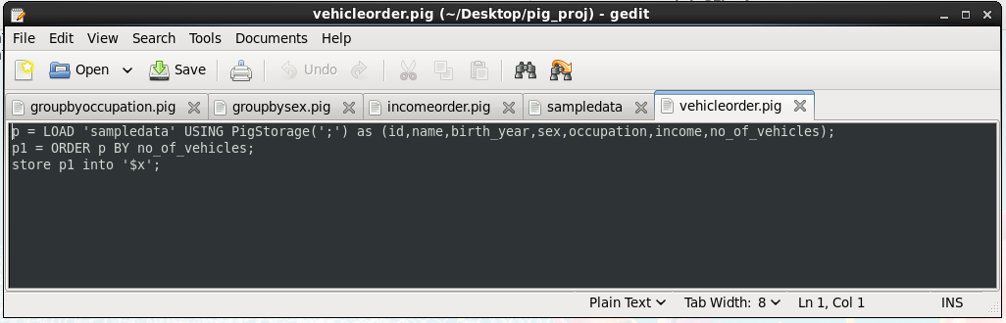
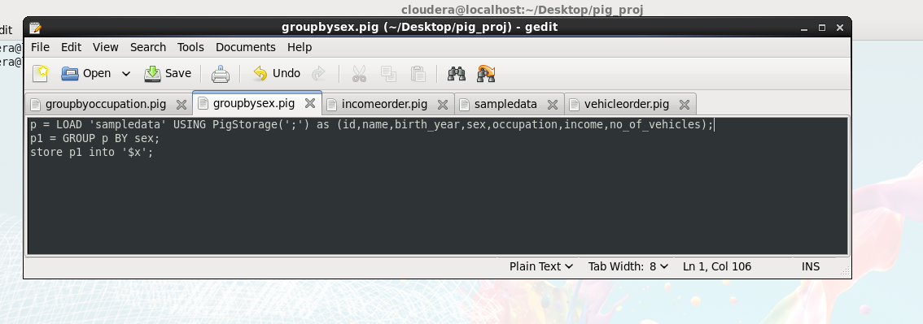
WRITING PIG SCRIPIT IN .PIG FILE
WRITING PIG SCRIPIT IN .PIG FILE

Slide 23
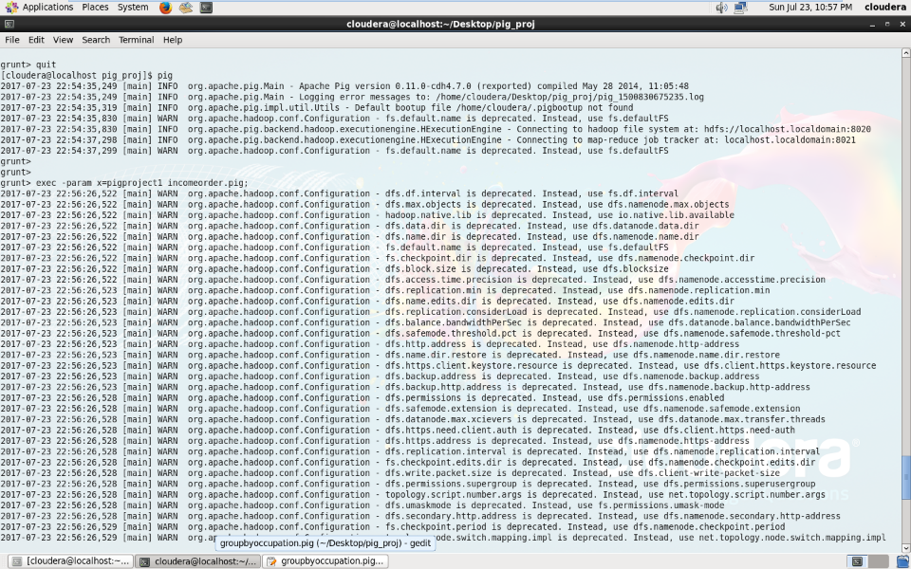
EXECUTION OF PIG SCRIPIT

Slide 24
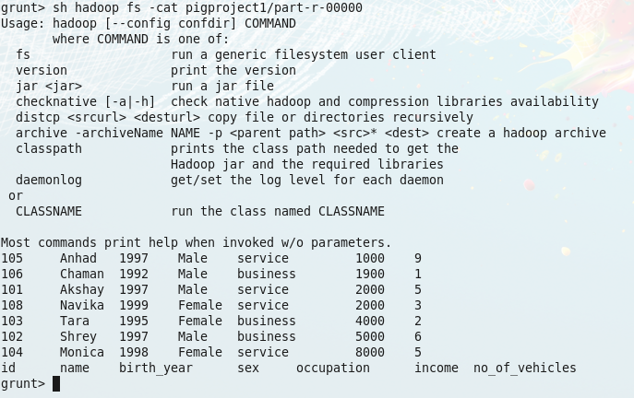
VIEWING THE OUTPUT FILE

Slide 25

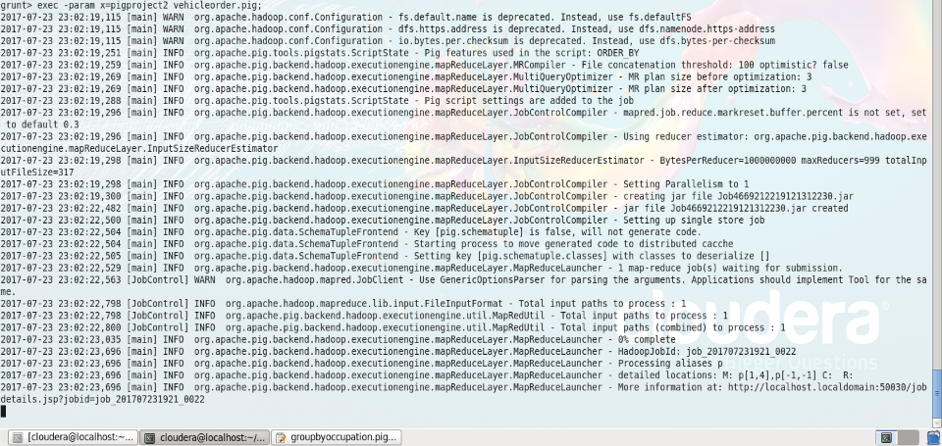

Slide 26
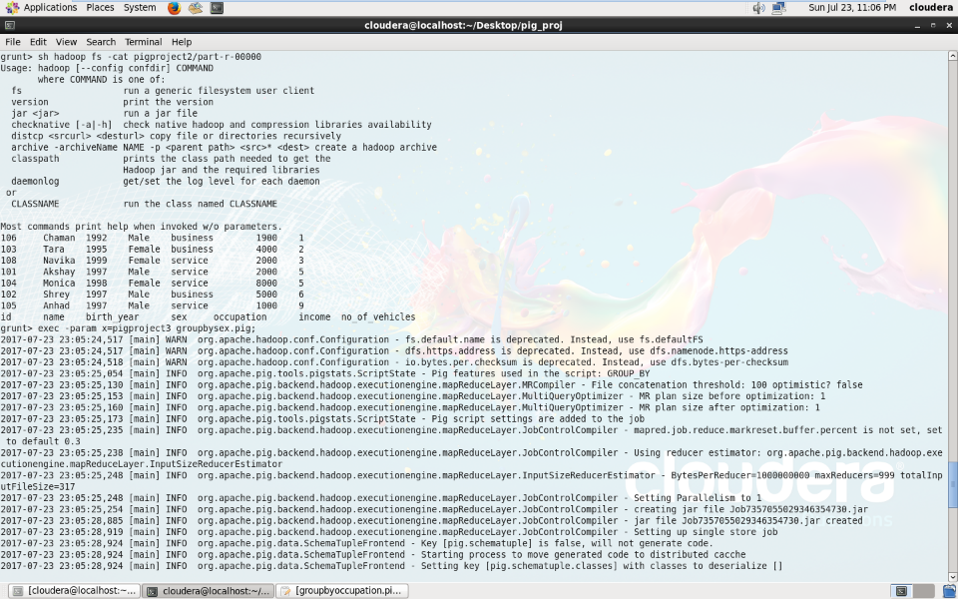


Slide 27
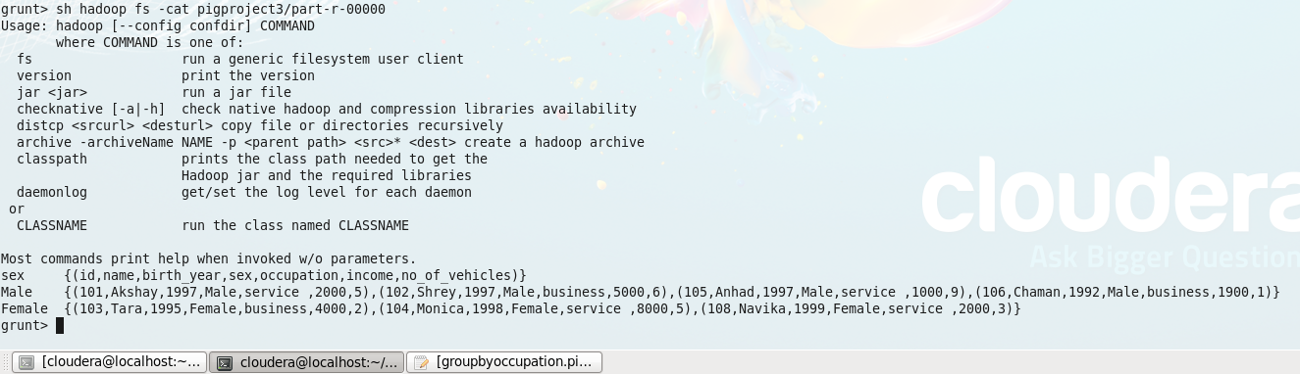

Slide 28
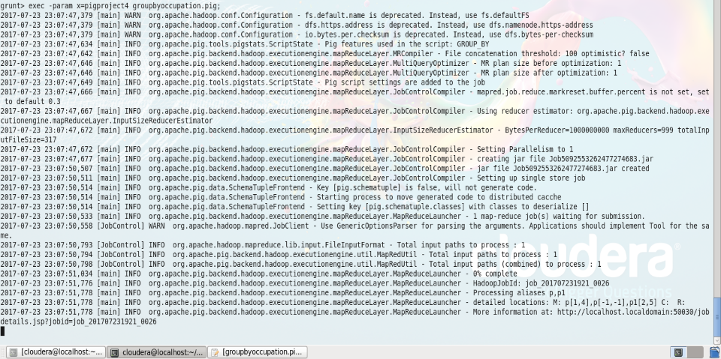

Slide 29
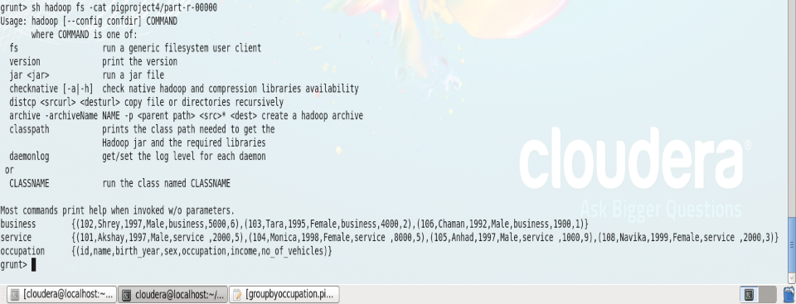

Slide 30
Hive is a data warehouse infrastructure tool to process structured data in Hadoop. It resides on top of Hadoop to summarize Big Data, and makes querying and analyzing easy.
3
HIVE

Slide 31
HOW TO RUN ANALYSIS USING HIVE :
CREATE A DATABSE
CREATE TABLE
LOAD DATA IN TABLE
RUN SQL QUERY

Slide 32
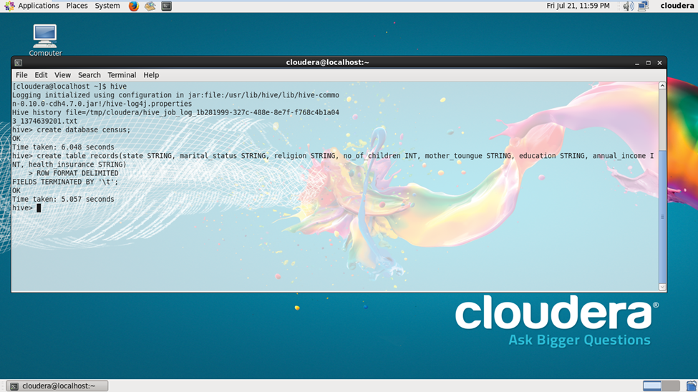
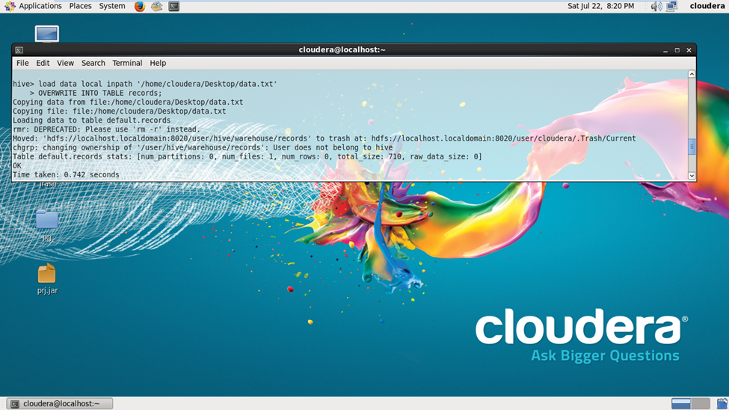
CREATING DATABASE AND TABLE
LOADING DATA IN TABLE

Slide 33
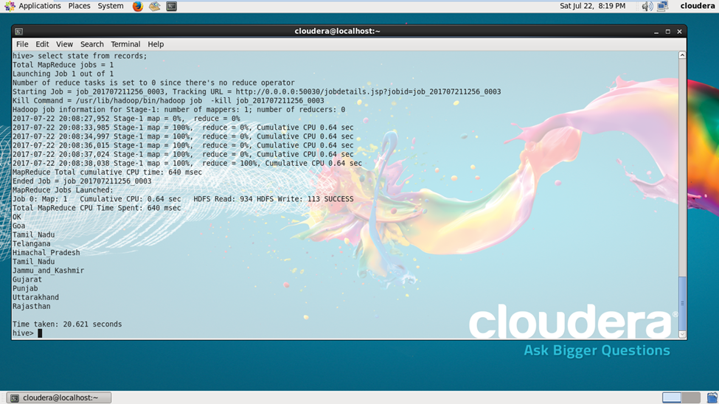



Slide 34
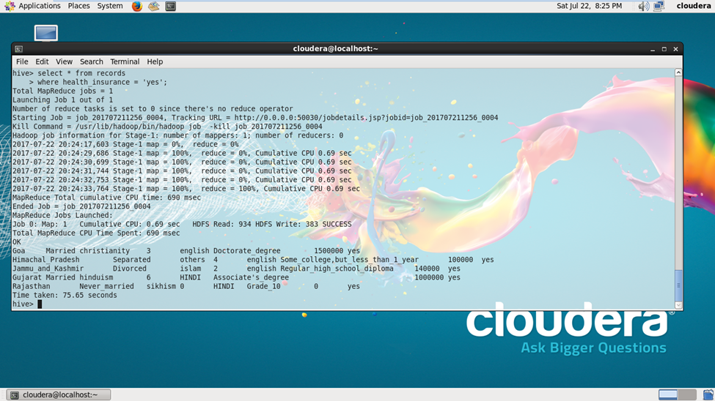
SQL QUERY
OUTPUT

Slide 35
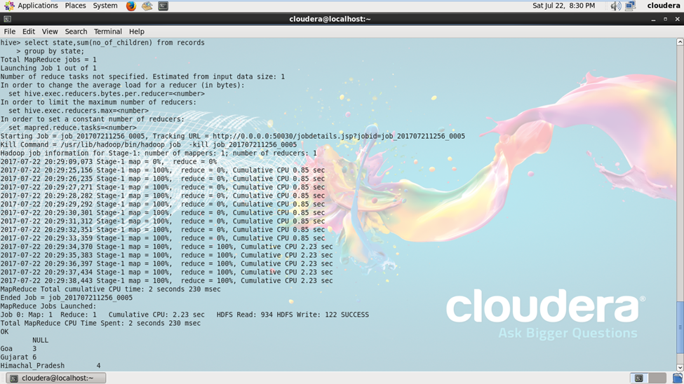

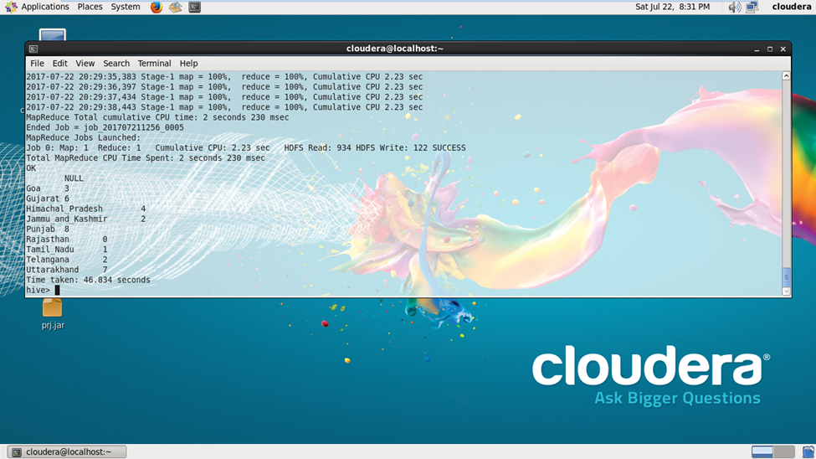

Slide 36
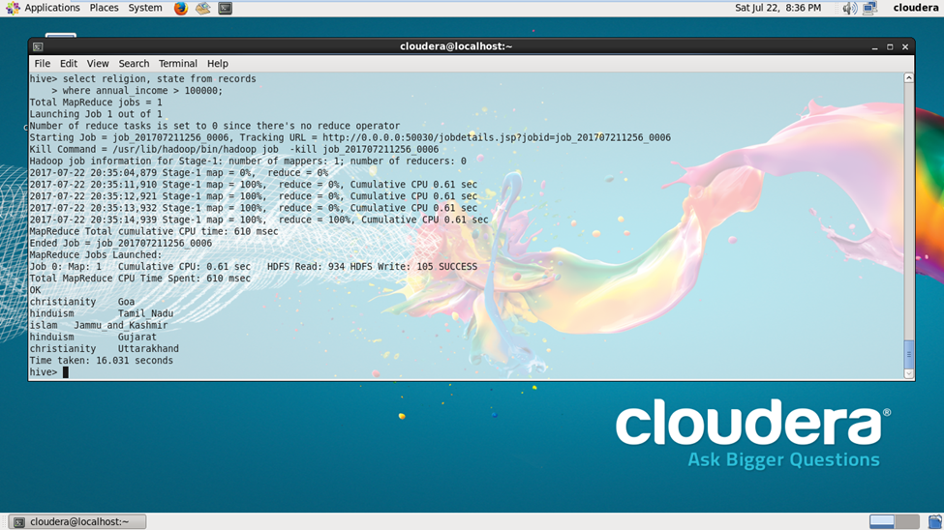



Slide 37
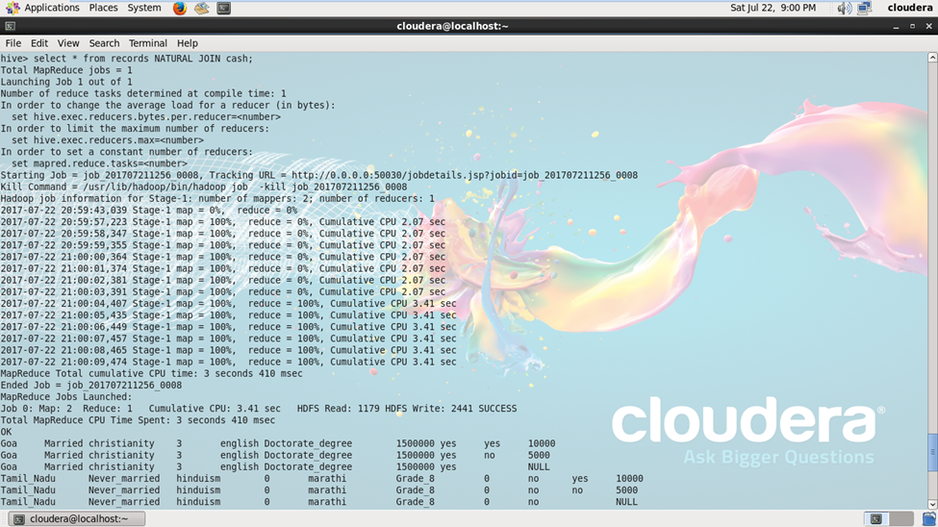

Slide 38
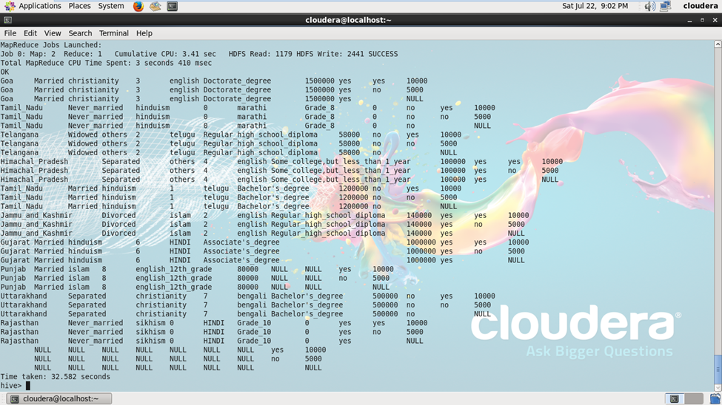

Slide 39
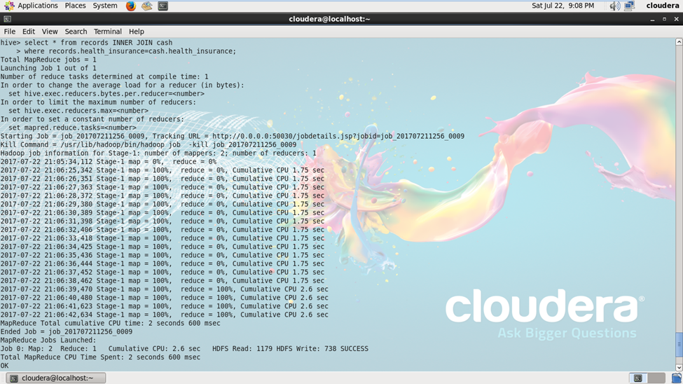

Slide 40
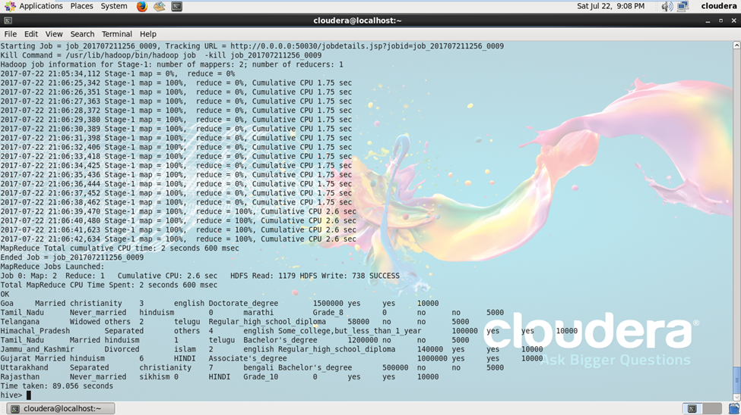

Slide 41





CENSUS ANALYSIS PROJECT BY - AKSHAY KHATTER
What’s Your Message?
akshaykhatter97@gmail.com

